Slide 1
Datacaptatie & visualisatie
Lab 4 Node-RED Dashboarding - functions

Slide 2
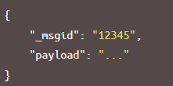
Node-RED : messages
A Node-RED flow works by passing messages between nodes. The messages are simple JavaScript objects that can have any set of properties. An object in Node-RED is a Java Script object that contains key-value pairs.
The default property is the payload property.
Node-RED also adds a property called _msgid, this is an identifier.
The value of a propery can be any valid JavaScript type, such as:
Boolean - true, false
Number - eg 0, 123.4
String - "hello"
Array - [1,2,3,4]
Object - { "a": 1, "b": 2}
Null

Slide 3
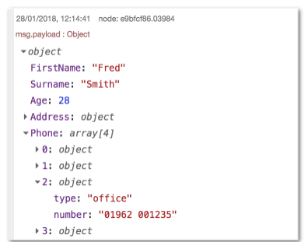
Node-RED : structure of message
When displaying an Array or Object, the sidebar provides a structured view that can be used to explore the message.
At the top it shows the name of the property that has been passed in. Here, the default msg.payload has been used.
Next to the property name is the type of the property - Object, String, Array etc.
It then shows the contents of the property. For Arrays and Objects, the property is collapsed into a single line. By clicking on it, the property will expand to show more detail.

Slide 4
Node-RED : functions
The Function node allows JavaScript code to be run against the messages that are passed through it.
The message is passed in as an object called msg. By convention it will have a msg.payload property containing the body of the message.
Other nodes may attach their own properties to the message, and they should be described in their documentation.

Slide 5

Javascript
JavaScript is a versatile, high-level programming language primarily used for web development.
Key Features:
Interactivity: Adds dynamic behavior to web pages (e.g., form validation, interactive maps).
Versatility: Can be used for both client-side (browser) and server-side (Node.js) development.
Event-Driven: Responds to user actions like clicks, form submissions, and keyboard input.
Object-Oriented: Supports objects and classes, enabling modular and reusable code.
Integration: Works seamlessly with HTML and CSS to create rich web applications.
Popular Libraries/Frameworks: React, Angular, Vue.js, jQuery.

Slide 6

Node.js
Node.js is an open-source, cross-platform JavaScript runtime environment used for executing JavaScript code outside of a web browser.
Node-RED is built on Node.js for several compelling reasons:
Node.js uses an event-driven, non-blocking I/O model, which makes it highly efficient and suitable for real-time applications. This model allows Node-RED to handle multiple connections and events simultaneously without blocking the execution.
Lightweight Runtime: Node.js provides a lightweight runtime environment, making it ideal for running on low-cost hardware like Raspberry Pi as well as in the cloud.
JavaScript Ecosystem: Node.js leverages JavaScript, a widely-used and versatile programming language. This allows Node-RED to benefit from the extensive ecosystem of JavaScript libraries and modules available through npm (Node Package Manager).

Slide 7
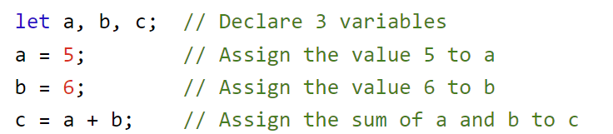
Javascript : intro
https://www.w3schools.com/js/
Javascript is most often used to control the behavior of web pages. (We’ll skip that part)
We’ll use Javascript in the backend. (server-side)
A JavaScript program (or Node-RED function) is a list of programming statements.
Semicolons separate JavaScript statements.
JavaScript ignores multiple spaces.
Add a semicolon at the end of each executable statement:

Slide 8
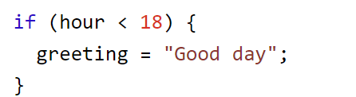
Javascript : intro
JavaScript statements can be grouped together in code blocks, inside curly brackets {...}.
The purpose of code blocks is to define statements to be executed together.
One place you will find statements grouped together in blocks, is in JavaScript if statement:

Slide 9
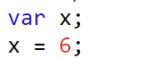
Javascript : intro variables
In a programming language, variables are used to store data values.
JavaScript uses the keywords var, let and const to declare variables.
An equal sign is used to assign values to variables.
In this example, x is defined as a variable. Then, x is assigned (given) the value 6:
Numbers are written with or without decimals: 10 16.78
Strings are text, written within double or single quotes: “SEM” ‘SEM’

Slide 10
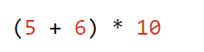
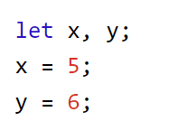
Javascript : intro variables
JavaScript keywords are used to identify actions to be performed. The let or var keyword tells the environment to create a variable.
JavaScript uses arithmetic operators ( + - * / ) to compute values:
JavaScript uses an assignment operator ( = ) to assign values to variables:
The values can be of various types, such as numbers and strings.
For example, "John" + " " + "Doe", evaluates to "John Doe":

Slide 11
Javascript : intro variables
Variables are Containers for Storing Data
JavaScript Variables can be declared in 4 ways:
Automatically (older JavaScript)
Using var (older JavaScript)
Using let (Modern JavaScript)
Using const (Modern JavaScript)
It is considered good programming practice to always declare variables before use.

Slide 12
Javascript : intro variables
When to Use var, let, or const?
1. Always declare variables
2. Always use const if the value should not be changed
3. Always use const if the type should not be changed (Arrays and Objects)
4. Only use let if you can't use const
5. Only use var if you MUST support old browsers.😒

Slide 13
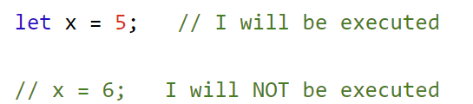
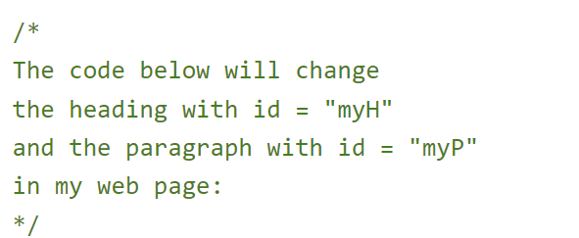
Javascript : comment
Not all JavaScript statements are "executed".
Code after double slashes // or between /* and */ is treated as a comment.
Comments are ignored, and will not be executed:
Multi-line comments start with /* and end with */.

Slide 14
Javascript : identifiers/names
Identifiers are used to name variables and keywords, and functions.
The rules for legal names are the same in most programming languages.
A JavaScript name must begin with:
A letter (A-Z or a-z)
A dollar sign ($)
Or an underscore (_)
Subsequent characters may be letters, digits, underscores, or dollar signs.
Numbers are not allowed as the first character in names.
Javascript is casesensitive

Slide 15
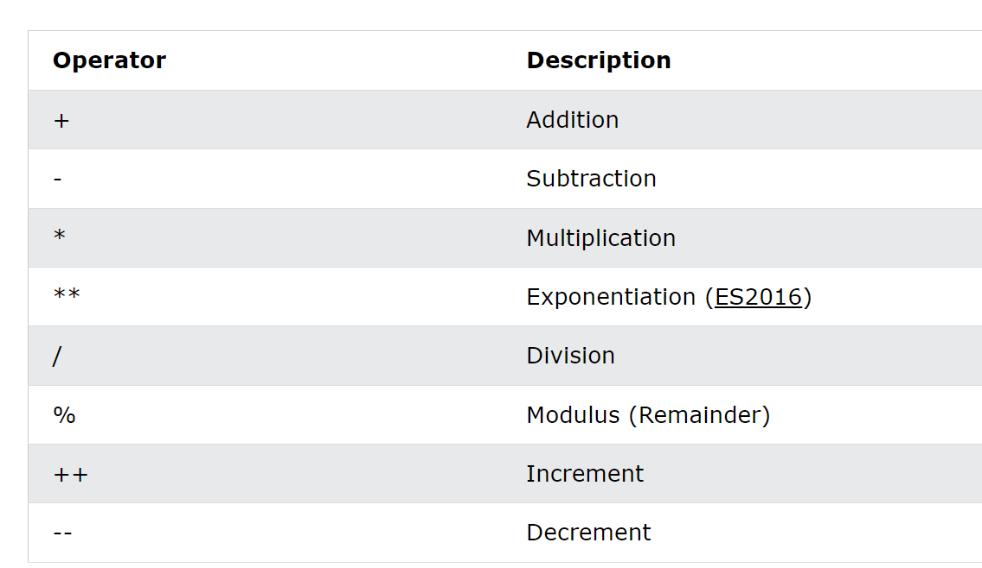
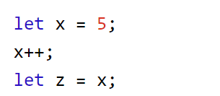
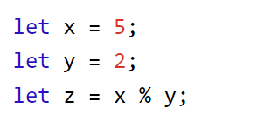
Javascript : arimetric operators

Slide 16
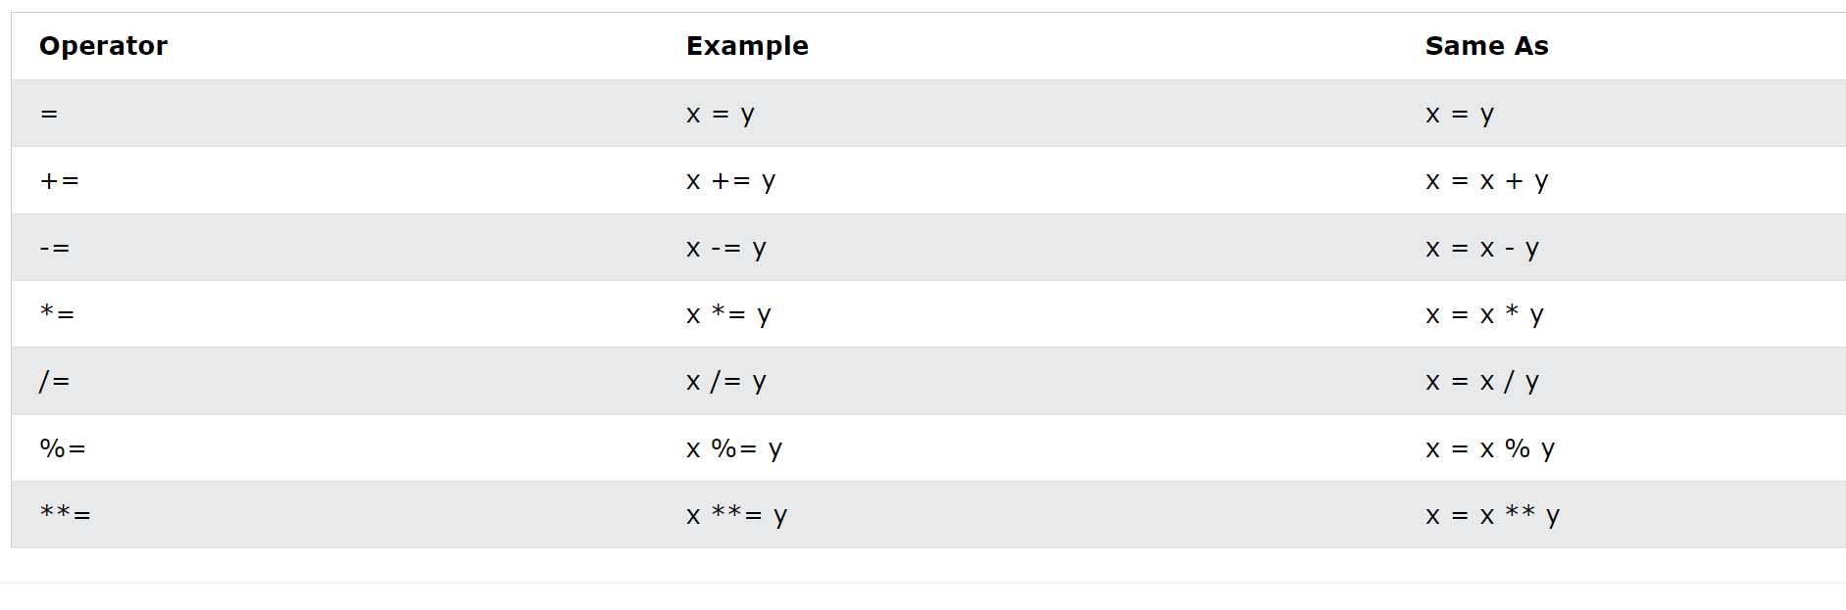
Javascript : assignment operators

Slide 17
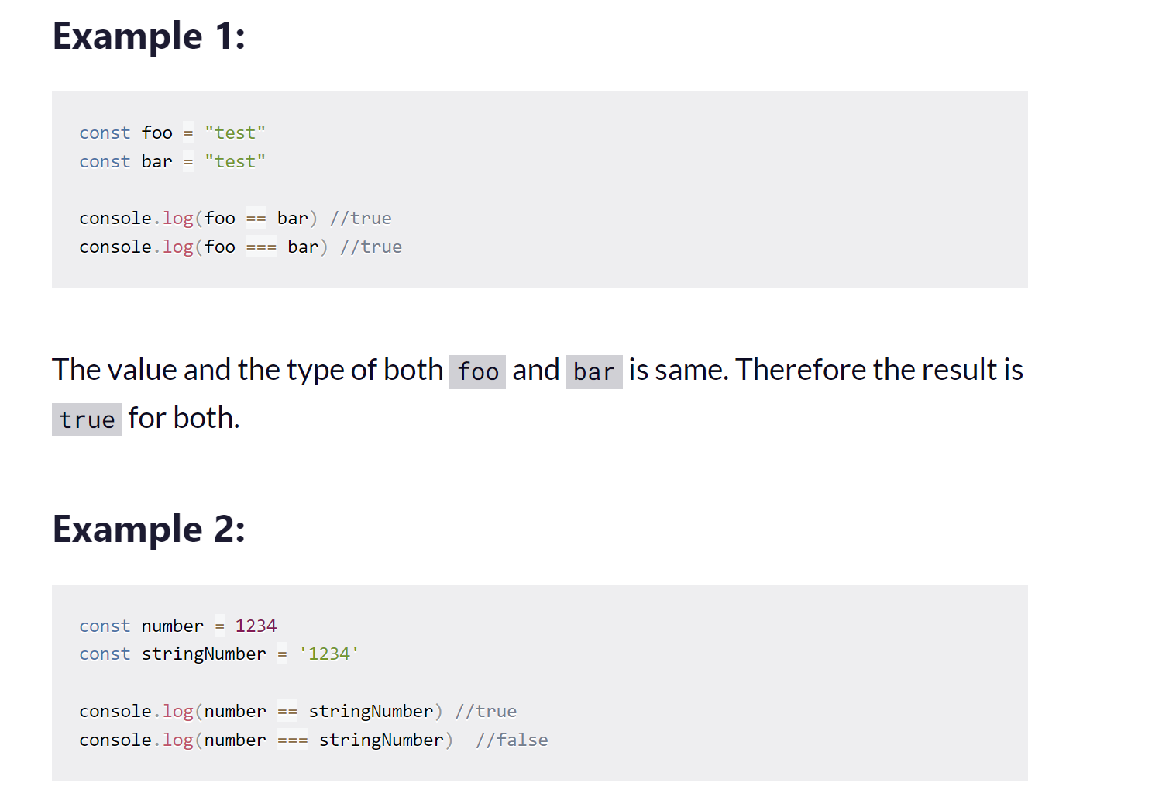
Javascript equality operator
The === operator will not do type conversion.

Slide 18
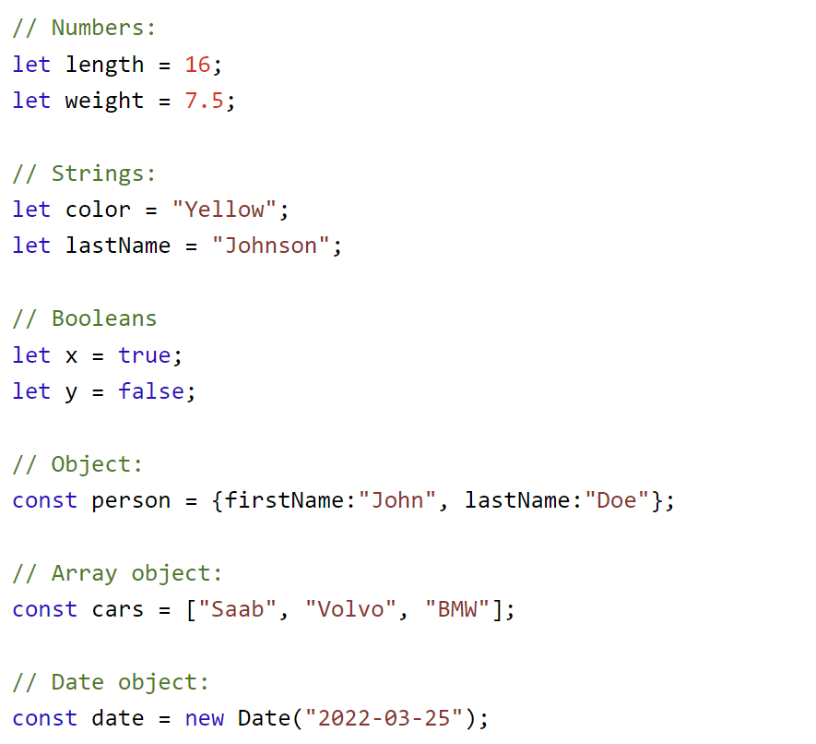
Javascript : datatypes
JavaScript has 8 Datatypes
String
Number
Bigint
Boolean
Undefined
Null
Symbol
Object

Slide 19
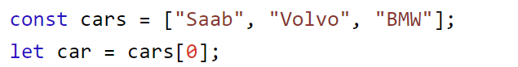
Javascript : arrays
An array is a special variable, which can hold more than one value.
Rectangle brackets
Accessing array elements

Slide 20
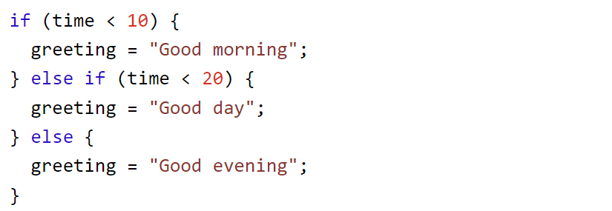
Javascript : conditional statements
Very often when you write code, you want to perform different actions for different decisions.
You can use conditional statements in your code to do this.
In JavaScript we have the following conditional statements:
Use if to specify a block of code to be executed, if a specified condition is true
Use else to specify a block of code to be executed, if the same condition is false
Use else if to specify a new condition to test, if the first condition is false
Use switch to specify many alternative blocks of code to be executed

Slide 21
Javascript : loop
JavaScript supports different kinds of loops:
for - loops through a block of code a number of times
for/in - loops through the properties of an object
for/of - loops through the values of an iterable object
while - loops through a block of code while a specified condition is true
do/while - also loops through a block of code while a specified condition is true

Slide 22
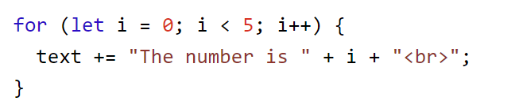
Javascript : for loop
The for statement creates a loop with 3 optional expressions:
Expression 1 is executed (one time) before the execution of the code block.
Expression 2 defines the condition for executing the code block.
Expression 3 is executed (every time) after the code block has been executed.

Slide 23
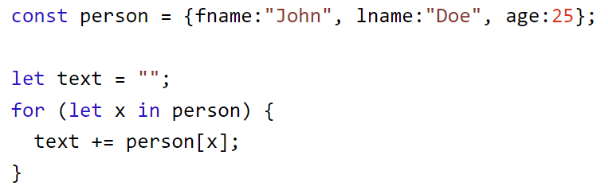
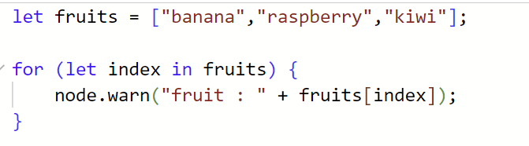
Javascript : for in
The JavaScript for in statement can also loop over the properties of an Array:
The for in loop iterates over an object
Each iteration returns a key (x) or an index
The key or index is used to access the value of the key or index
The value of the key is person[x]

Slide 24
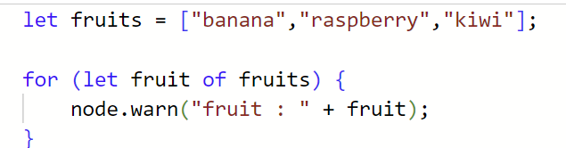
Javascript : for of
The JavaScript for of statement loops through the values of an iterable object.
It lets you loop over iterable data structures such as Arrays, Strings, Maps, NodeLists, and more:

Slide 25
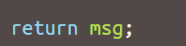
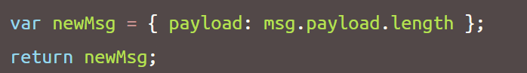
Node-RED : writing a function
The code entered into the Function node represents the body of the function. The simplest function returns the message exactly as-is:
The function must always return a msg object. Returning a number or string will result in an error.
The returned message object does not need to be same object as was passed in; the function can construct a completely new object before returning it. For example:
constructing a new message object will lose any message properties of the received message.

Slide 26
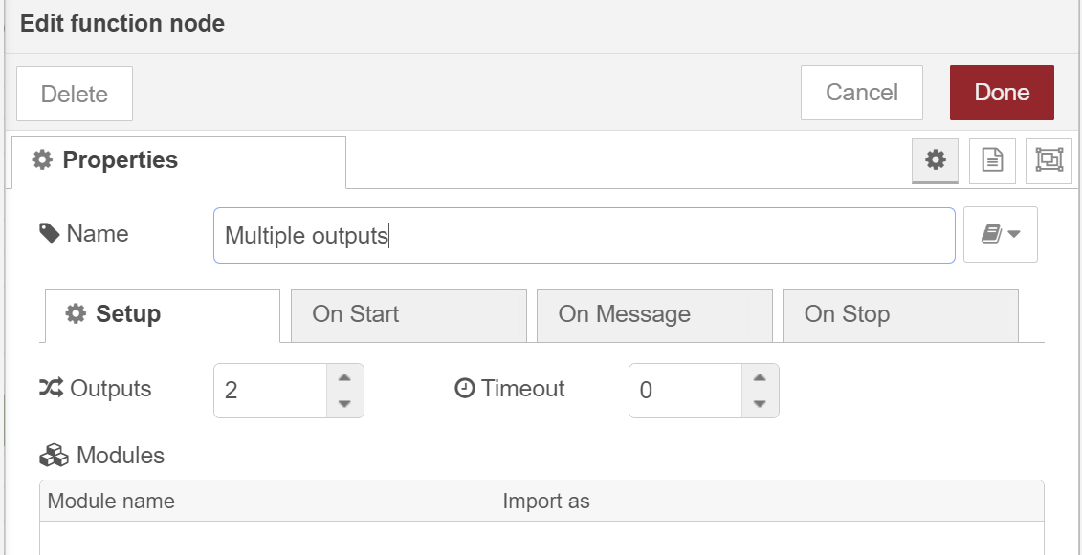
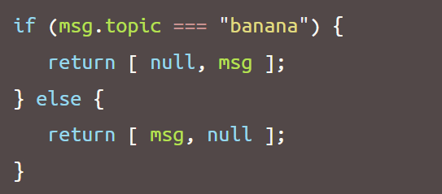
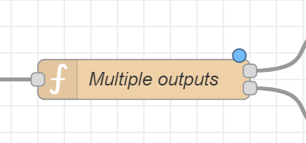
Node-RED : Multiple outputs
The function edit dialog allows the number of outputs to be changed. If there is more than one output, an array of messages can be returned by the function to send to the outputs.
This makes it easy to write a function that sends the message to different outputs depending on some condition. For example, this function would send anything on topic banana to the second output rather than the first:

Slide 27
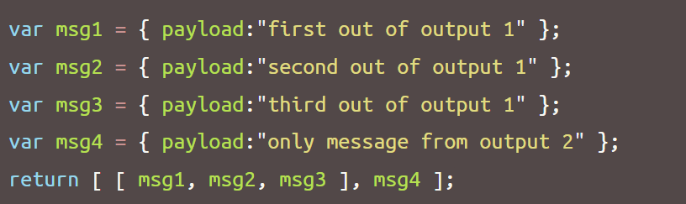
Node-RED : Multiple messages
A function can return multiple messages on an output by returning an array of messages within the returned array. When multiple messages are returned for an output, subsequent nodes will receive the messages one at a time in the order they were returned.
In the following example, msg1, msg2, msg3 will be sent to the first output. msg4 will be sent to the second output.

Slide 28
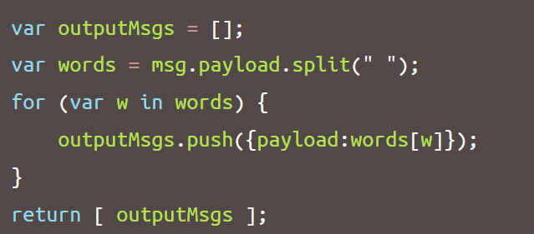
Node-red : Multiple messages
The following example splits the received payload into individual words and returns a message for each of the words.

Slide 29
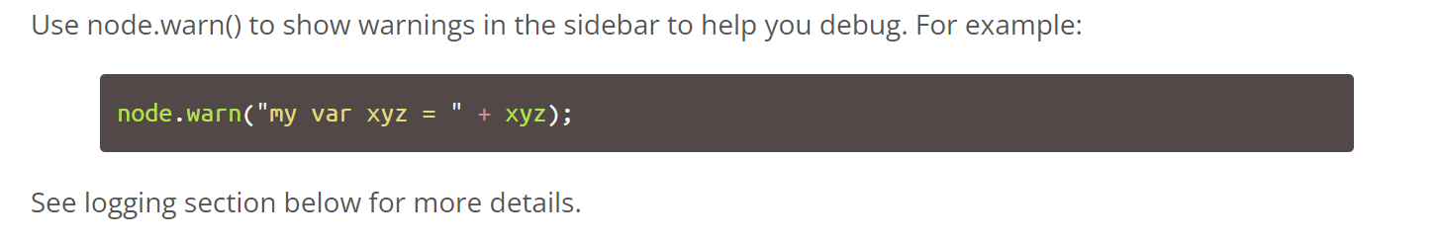
Logging

Slide 30
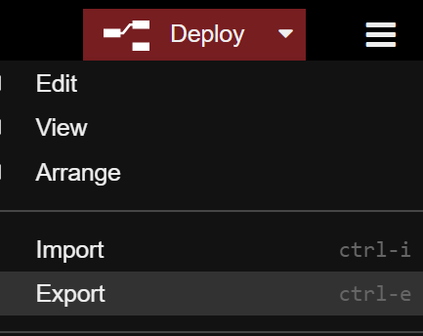
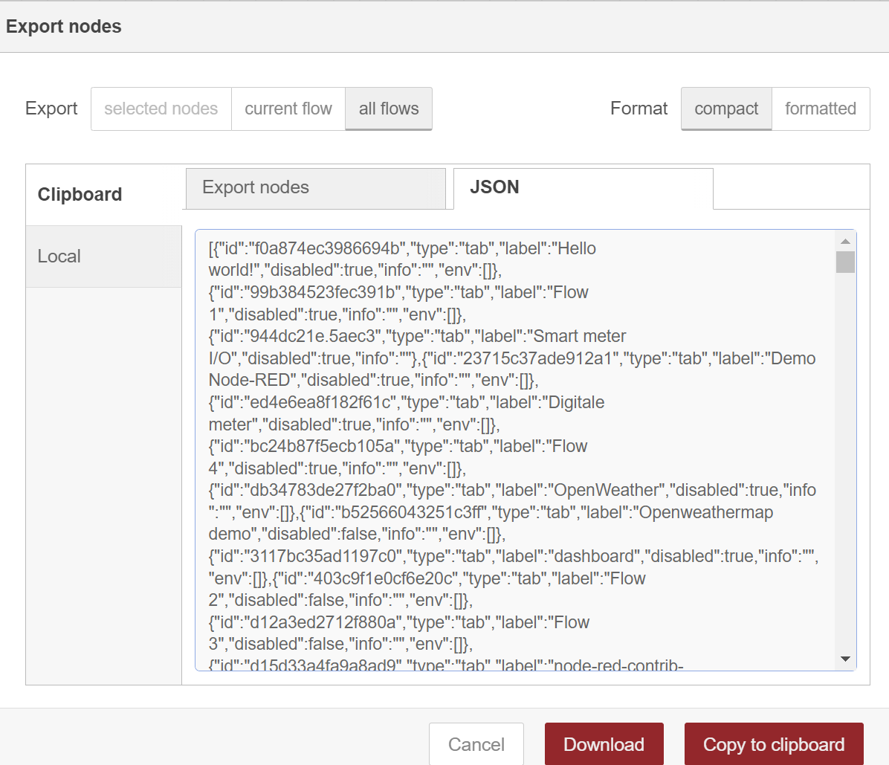
Exercise
Download the current flow and store it in a place e.g. datacaptatie_flows
Select all flows and compact format
Store it in a place e.g. datacaptatie _flows and give it name e.g. flow01_ datacaptatie.json
Delete all the flows

Slide 31
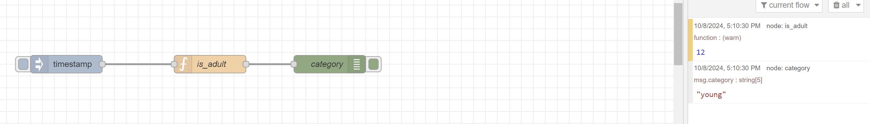
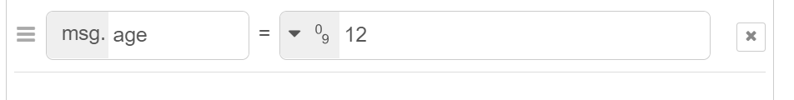
Exercise 1
Create the following flow:
Write an if statement that checks the age of a person. If the person is older then 18, then the person is an adult otherwise the person is young.
Tips:
use a number as datatype
Use “age” as extra msg key
Use node.warn(msg.age);

Slide 32
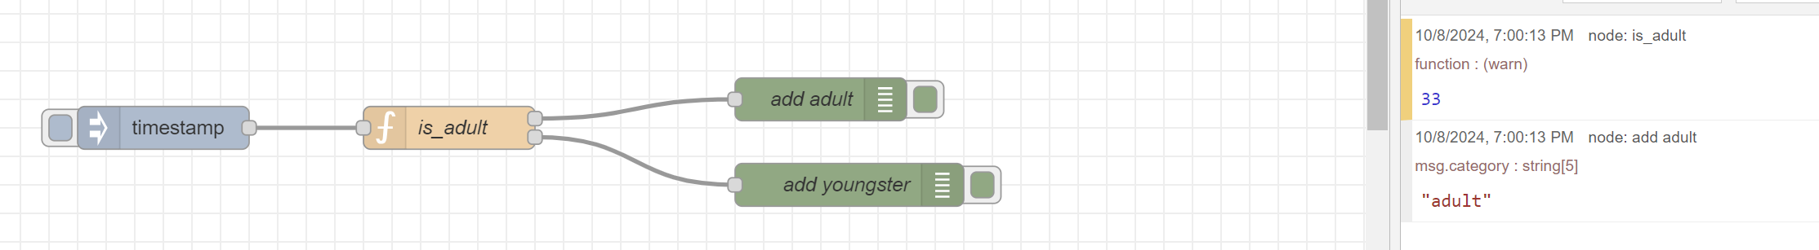
Exercise 2a
Adjust the previous exercise, create a function with 2 outputs
Add the flow variable add adult and add youngster

Slide 33
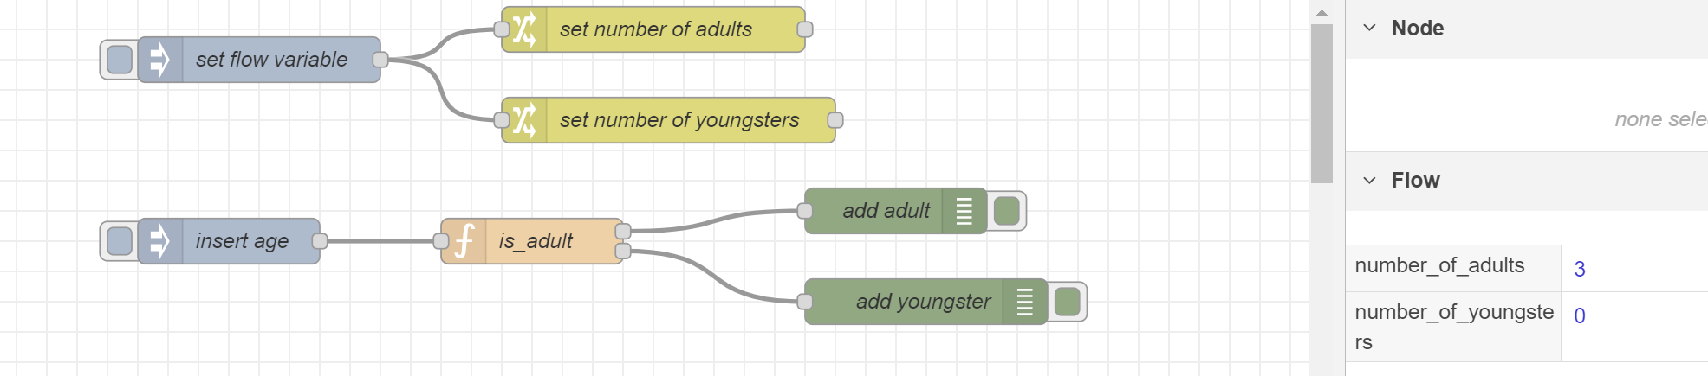
Exercise 2b
Initialize the flow variable number_of_adults and number_of_youngsters
Count the number of adults and young people (change the age of the inject node)
Show the number of adults or youngsters

Slide 34
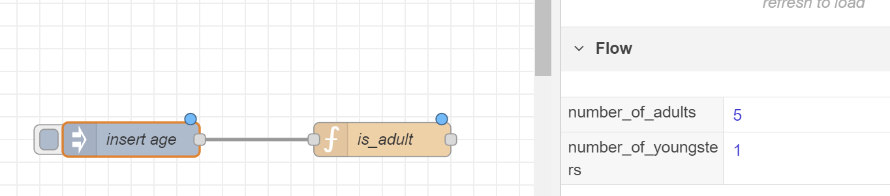
Exercise 2C
Make an array list with people’s ages, add this to the inject node [3,56,34,23,88,18]
Adjust the function node is_adult to count all those people

Slide 35
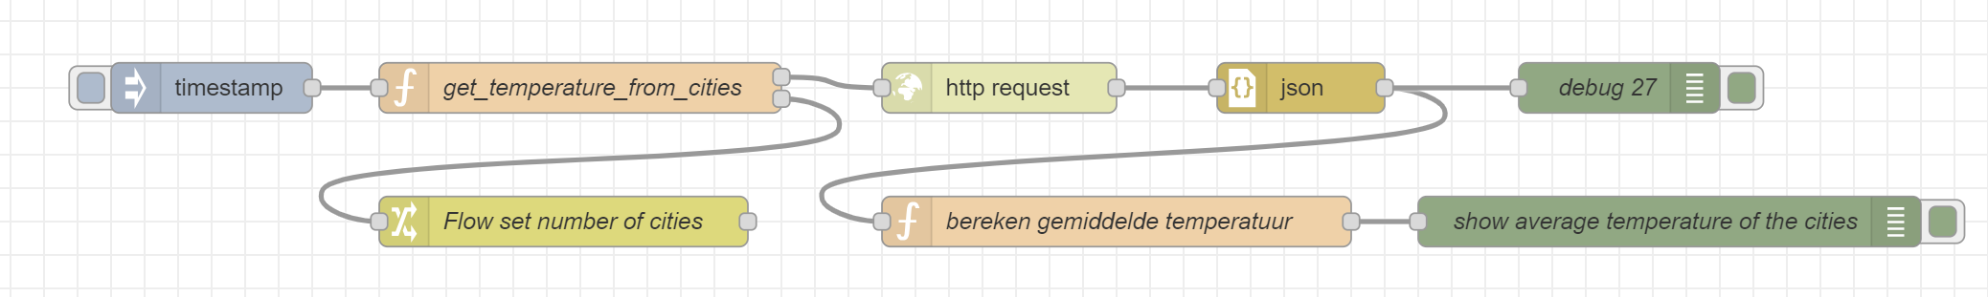
Exercise 3
Make a list of different cities.
Calculate the average temperature of those cities.

Slide 36
Sources
https://nodered.org/
https://nodered.org/docs/tutorials/
https://noderedguide.com/

